Slide 1
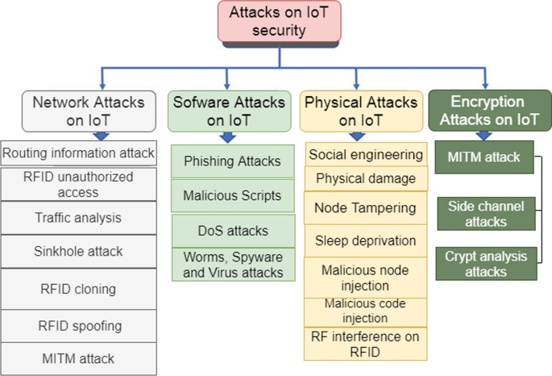
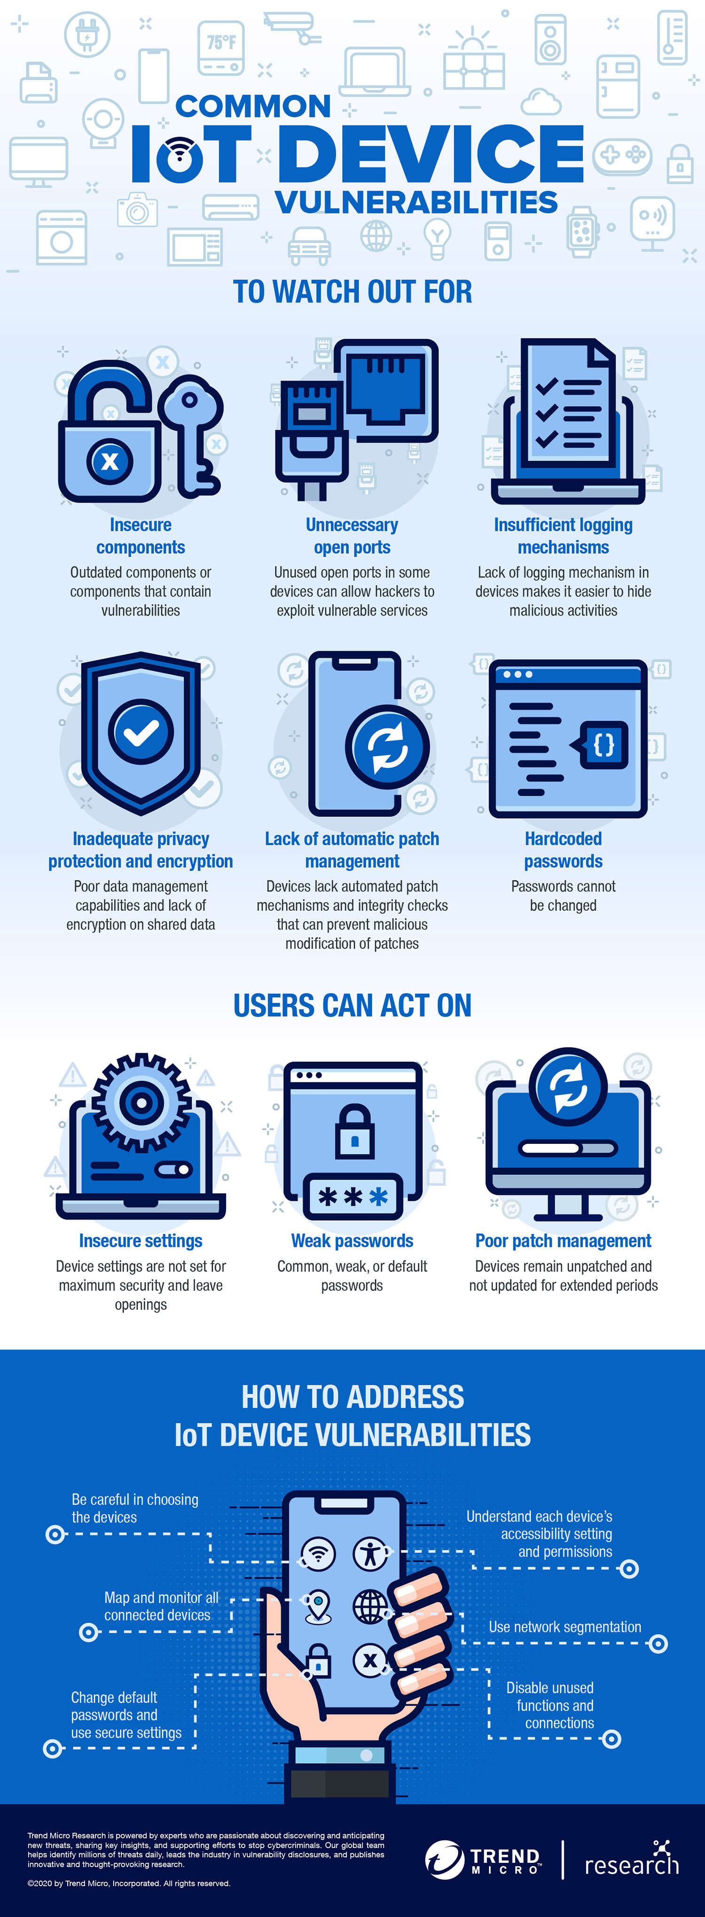
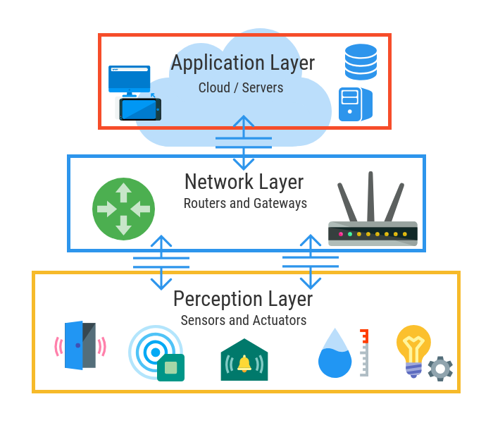
SECURITY FOR IoT SYSTEMS
M00783479
M00783479
Practice that keeps IoT systems safe, by applying security tools that protect the system from threats & breaches, identify & monitor risks and can help fix vulnerabilities while ensuring the availability, integrity, and confidentiality of the system.
IoT Architecture
Network security
Secured firmware, anti-virus security firewalls, and intrusion detection/prevention systems.
Network division
Secure end-end communication with encryption ,
-IoT PKI security methods
-IoT security analytics
-API security methods
-monitoring of IoT apps
Data confidentiality and privacy; minimize sensitive data entry, check the privacy policy of apps & disable unwanted features.

